Slide 1
HR RECRUITMENT AND TRAINING PLANS Team – Jupiter Head – HR Department
In current situation there is highly competitive and in order to grow or survive in scenario , it is necessary to invent and adopt new technology for business . Our company has decided to venture into ‘Hyper Local Delivery Space’ and looking ahead to conduct local deliveries through Drones. So, here I come into the picture as an HR Manager to support company’s division of Drone Business and goals.

Slide 2
Recruitment Plan
Sr No. | Designation | Department Managers | Salary (average salary as per month) | Qualification
1. | Management team | Administration Manager Marketing Manager Human Resource Manager Business Analytics Finance Manager | 1,00,000 | Bachelor’s degree 3years + MBA ( 3-year experience)
2. | Software | Project manger Software manager | 25,00,000 | BE Engineer (2 years experience)
3. | Drone Operator | Navigate Drone Weather monitoring | 50,000 | SSC /HSC + Remote Pilot Certificate from FAA (2-year experience)
4. | Software development team | Program Manager | 70,000 | BE technical (3-year experience)
5. | Support Staff | Packaging manager Customer care | 20,000 | HSC Passed

Slide 3
Training Plan
TEAM TRAINING PLAN
Training is process where employees improve decision making , problem solving , working in team by coordinating with team members. Training helps for achieving goals it helps improving tools , equipment, documents or materials that trainees will use when fully trained.
Managerial and Supervisory Skills
Communication skills
Products and Service Training
Technical skills and development
Making workplace more enjoyable
Motivating employees
Time Management

Slide 4
BASIC TRAINING MODULE FOR WORKFORCE
Introduction to the company
Health & Safety in the workplace
Systems training on Epos
Discipline
TRAINING FOR PRODUCTS
Pre-Flight Checklist & Compass Calibration
How to Safely Launch Your Drone
Basic Drone Controls & Responsive Control
Directional Control
Flying The Box
GPS vs. ATTI Mode
How to Safely Land Your Drone
Post Flight & Flight Logbook

Slide 5
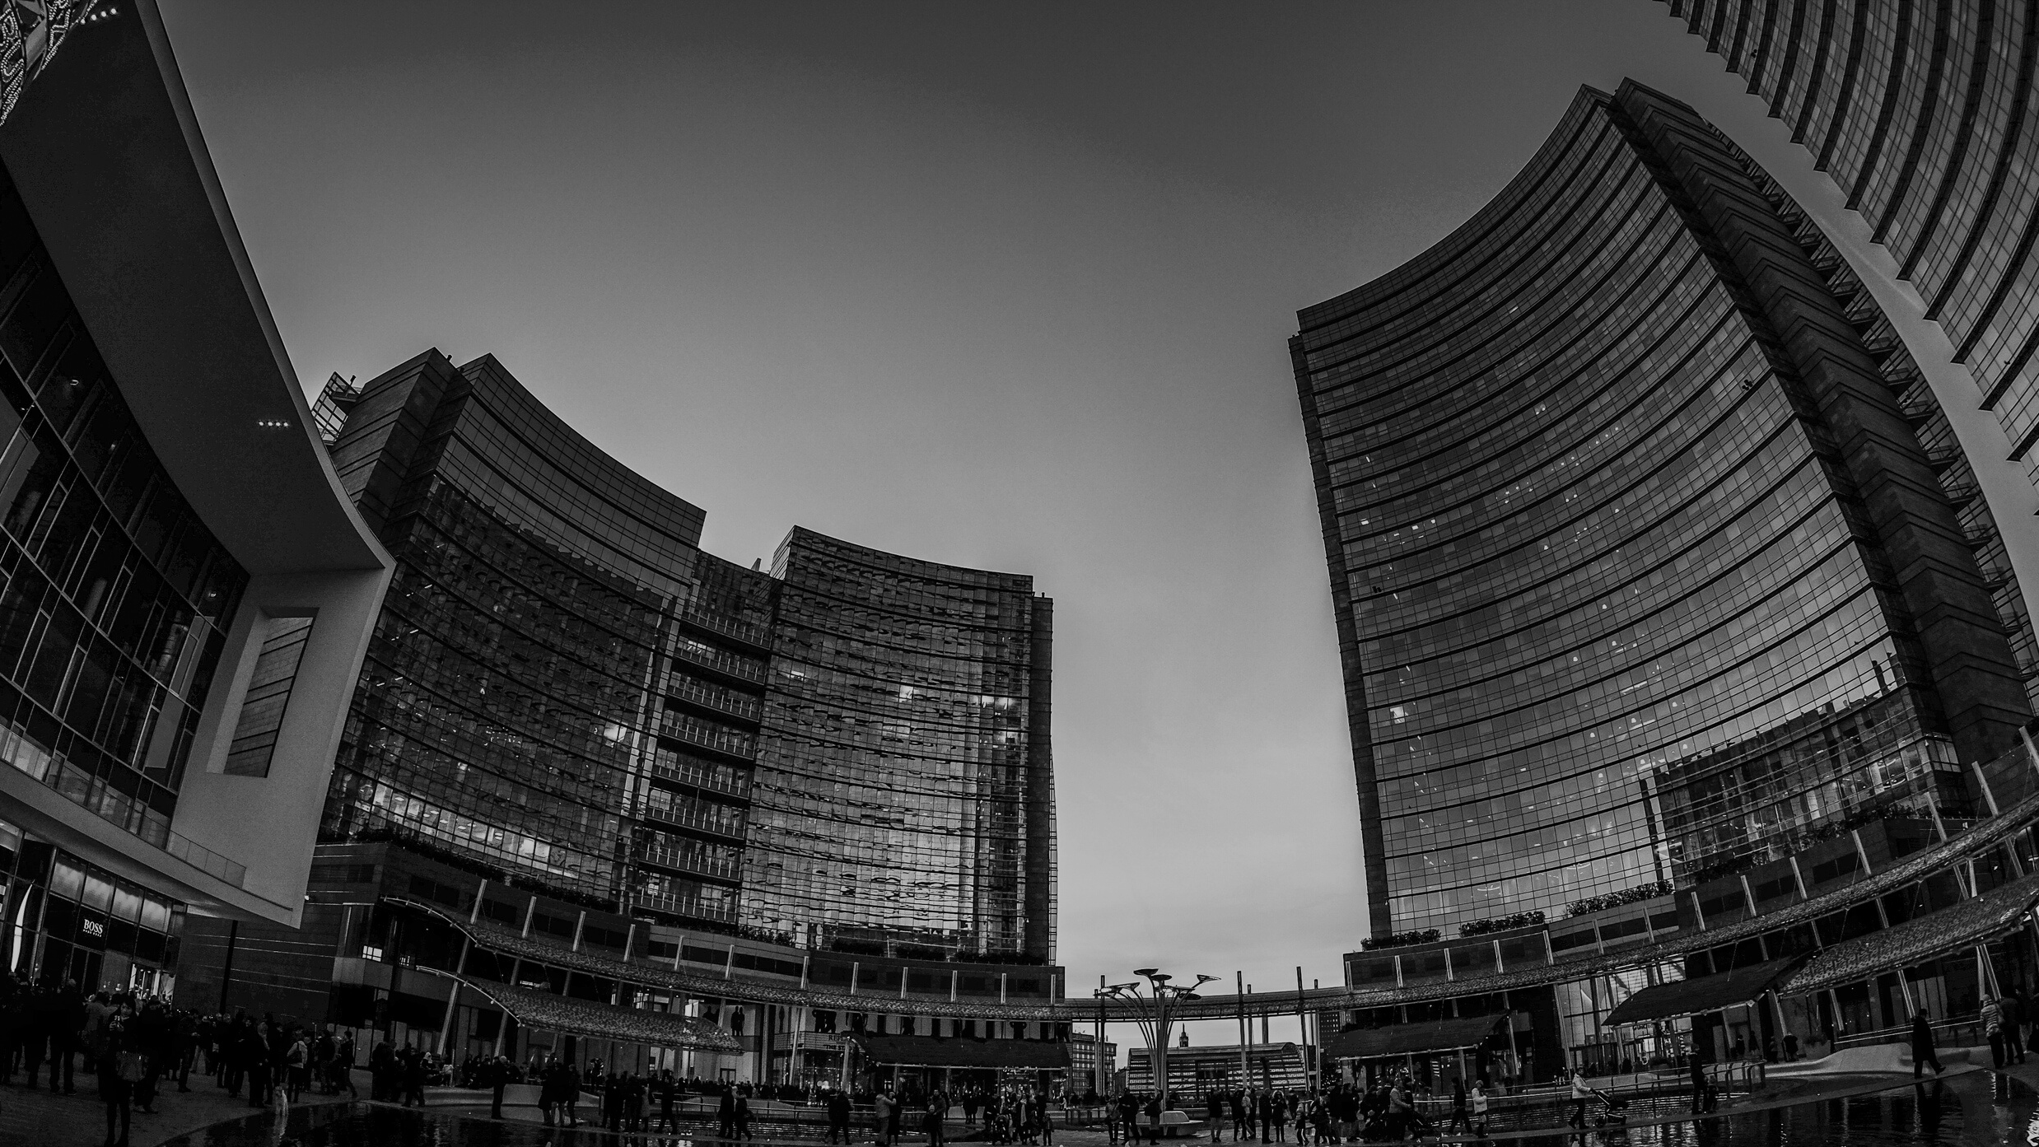
Elite Courier Service
Presented by: Miss. Khushali Sapariya

Slide 6
AGENDA
Highlights and Key Updates
Sales Target
Expenditure Budget

Slide 7
Financial Planning
Financial planning ensures reserving future cash flow to business technology elements and comparing actual spend by business technology elements.
Highlights and Key Updates
Financial Transparency
Financial transparency shows how accumulated costs are transferred to service consuming fees and how actually implemented to plans.
Financial Feasibility
Financial Feasibility focuses specially on financial aspects of the study.

Slide 8
Highlights and Key Updates
Our large enterprise segment earns the most revenue at the first stage of service.
40%

Slide 9
Item 4
14.3%
Item 2
5%
Item 3
5.3%
Item 9
26.2%
Item 1
39%
Item 4
20%
Item 3
26%
Item 7
1.9%
Item 5
5.3%
Item 2
20.8%
Item 6
33.3%
₹23,10,00,000
₹ 1,75,10,000
Revenue
Operating Cost
(+25% from last period)

Slide 10
Business Case Solution -Marketing Department
Elite Courier Services
Your Vision, we delivered

Slide 11
Marketing Mix
Product Service
- Empowering small agencies
- Provide offerings to large organizations
- Website or app to order products from nearby businesses
Pricing Strategy
Subscription-based model will be implemented
Prices based on the weight of orders
Customer will benefit either free or subsidized delivery according to the plan

Slide 12
Place
Area to be covered
Population density
Availability/set-up cost of support infrastructure
Eagerness of the population
Target Market
Clinics
Supermarkets
Café
Households

Slide 13
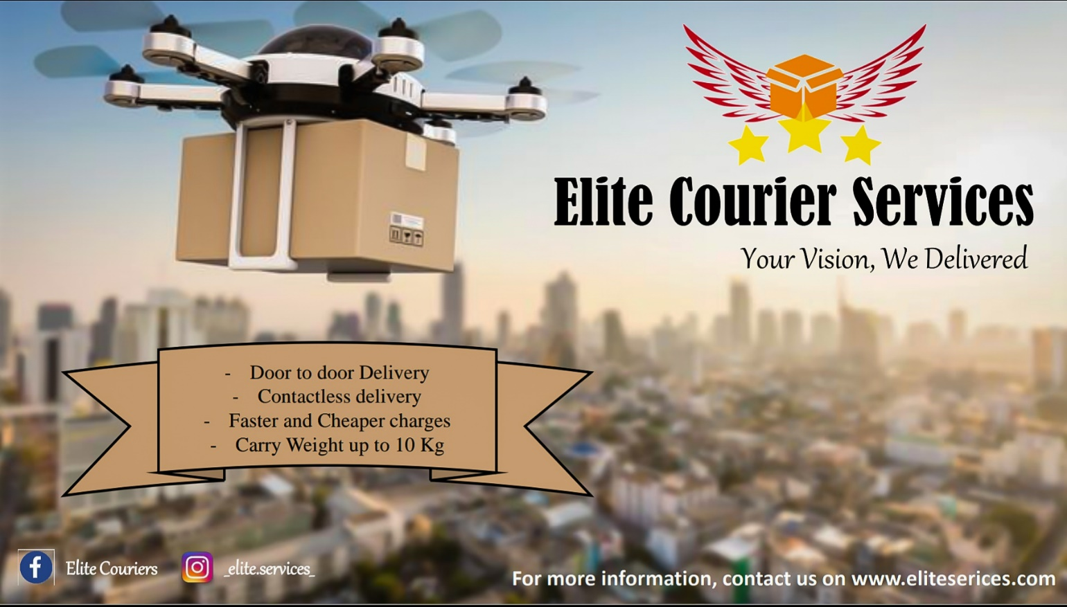
Promotion
- Campaign
- Co-Branding
- Reward System
- Promotional Activities
Elite Courier Services
Your Vision, We Delivered
Elite Couriers
Business Card
_elite.services_
Contact us on, www.eliteservices.com
Banners

Slide 14
Elite - IT Department
Manages the organization website.
Monitor the delivery of parcel from our office or warehouse to client destination.
Responsible for installing and maintaining of computer software and hardware for the organization.
Manages logistics and supply chain software, web server, ecommerce software and pass system.
Manages the organization’s CCTV.
Handles any other technological and it related duties.
Network setup and management.
Cloud service and setting up and maintaining backup system.

Slide 15
IT employee policy IT department will play a key role in setting up IT user policy. Security incident response policy data encryption policy, mobile device security policy Creating website In today’s world no company will survive without and online presence. The department will create the website. The website will take the order and the related services like tracking courier and parcel. Creating Android and iOS application No company can sustain the competition without having a well dedicated app that will enable recurring user to place order and track the couriers. The app will be created for android and iOS users.

Slide 16
Mobile field service tracking Task execution by field service stuff should adhere to the plans. Real time tracking helps you control each task’s status and react when needed. With field service scheduling software and GPS integration, you can track your courier. Hybrid cloud and network This system will exploit the benefits of the public cloud while maintaining the control we need with the private cloud to enable dynamic and optimised workload placement of courier deliveries to the customers. Social media handles The it department will look after the technicalities revolving around the social media handles regarding their privacy and security. The analytics sub-department will also look after the social media handle insight provided by the social media platforms.

Slide 17
ERP – enterprise resource planning There should be high degree of integration among this is team and process is we need to align this strategy such as order, reception management, financial management, HR etc. For this we subscribe to our ERP module most probably SAP. Server system The department will try to create for dedicated server room with a server expert whose work will resolve around setting up a server, managing it, troubleshooting, setting up email exchange services, putting up a firewall.

Slide 18
Service desk Available 24/7, service desk is a multichannel single point of contact with highly experienced IT specialist. Our service desk is all about delivering the right support and top customer experience. Communication and feedback To avoid situations which lead to customer dissatisfaction, we will communicate effectively by sending notifications or text messages of the issue, including details of when a parcel will deliver.

Slide 19
THANK YOU

